Slide 1
Average

Slide 2

Q1. The average of first 50 natural numbers is:

Slide 3

Q2. The average of 6 consecutive odd numbers is 20. The largest of these numbers is :
A)23
B)25
C)27
D)26

Slide 4

Q3. Score of 5 students in mathematics is 79.8, 83.7, 81.2, 78.9 and 81.4 respectively find their average score.
A)81.2
B)80
C)81
D)None

Slide 5
Q4. The average salary of 3 workers is Rs.95 per week. If one earns Rs.115 and the second earns Rs.65, how much is the salary of the 3rd worker?
A)85
B)95
C)105
D)None

Slide 6

Q5.Average of four subject is 75; he got 80 marks in 5th subject; new average=?
A)76
B)77
C)78
D)None

Slide 7

Q6.Average weight of 10 student is 10 Kg, another group of 15 students of average weight is 12 Kg join them, what is the average weight of all student
A)12.2
B)11.2
C)13.2
D)None

Slide 8

Q7. The average expenditure of a man for 10 days is Rs. 45 per day. If his average expenditure for the first 3 days is Rs. 52 per day, find his average expenditure for the remaining 7 days.
41
42
43
44

Slide 9

Q8. The average weight of 8 men is increased by 2 kg when one of the men, whose weight is 50 kg is replaced by a new man. The weight of the new man is
65
66
67
68

Slide 10

Q9.The average salary of the entire staff in an office = 120; average salary of officers = 460; average salary of non officers= 110; total officers= 15; find total non officers=?
A)510
B)610
C)590
D)None

Slide 11

Q10.The average weight of a class of 10 student is 20kg. When a student of weight 15kg is replaced by a teacher the average weight increases by 2 Kg. What is the weight of the teacher.
A)40
B)32
C)35
D)37

Slide 12
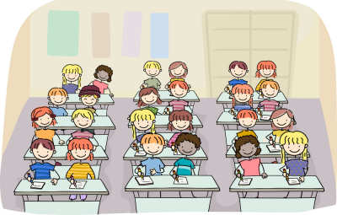
Q11.The average weight of the students of a class is 40 kg. If 5 new students with the average weight of 46 kg join the class, the average weight of the class is increased by 2 kg. Find the number of students in the class.
12
15
10
18

Slide 13
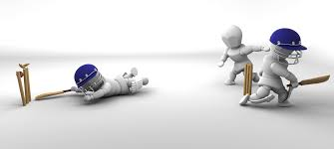
Q12. A man whose bowling average is 12.4 takes 5 wickets for 26 runs and there by decreases his average by 0.4. The number of wickets taken by him before his last match is:
85
80
90
95

Slide 14
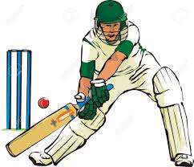
Q13. A batsman makes 90 runs in his 16th inning thereby his average decreases by 4, find his average after 16th inning.
A)150
B)160
C)154
D)None

Slide 15
Q14. Average of 13 results is 65. If the average of first six results is 61 and average of last six results is 59. Then find the seventh result
70
120
60
125

Slide 16
Q15. Out of 12 employs of a bank, one employ retires and his place, a new employ of age 24 years joins as a result average age of employs reduces by 4 years. The age of the retired employ is:
72
44
68
48

Slide 17
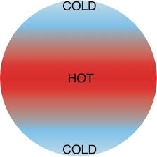
Q16. The average temperature of Monday, Tuesday, Wednesday and Thursday was 38∘ and that of Tuesday, Wednesday, Thursday and Friday was 40∘. If the temperature on Monday was 30∘, the temperature of Friday was
40
38
44
50

Slide 18
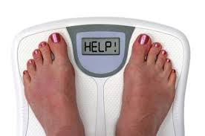
Q17. The average of weight of three men A,B and C is 84 kg. Another man D joins the group and the average now becomes 80 kg. If another man E, whose weight is 3 kg more than that of D, replaces A, then the average weight of B,C,D and E becomes 79 kg. The weight of A is :
70
75
80
85

Slide 19


